Slide 1
Behavioral Health Research Support
Information Service for Community Professionals

Slide 2
Goals
Fill a need for BH information support in community service agencies
Meet the information service needs of local BH professionals
Develop a public service model for the health sciences library program
Extend existing hospital research service to six counties
Build partnerships with behavioral health organizations and professionals

Slide 3
What Kinds of Requests Can I Make?
Notes:
These are the kinds of requests we typically handle—we can fill requests for copies of scholarly articles—we can usually get something within 48 hours if we don’t have it.
Free of charge of course.
Requesting a specific article
You can send us a citation or as much of the article citation as you know. The request form allows you to attach files, so you can send us a list of articles or you can take a picture of a citation with your phone and attach the image to the request form.
Request a Literature Search
You can ask us to research a subject or find articles on something specific—a syndrome, an illness, a procedure, a theory a program, whatever. The best thing is to be as specific as possible. If you feel you can’t put it in an email, you can call the help desk and leave the request there or ask us to call you. We will insist that you register in our system however, before we will help you.
Information for Patients and Families
We have resources at NIH and NLM that provide good patient information. We also have some premium resources—such as UPTODATE that also provide patient information and handouts.
We are not currently loaning or borrowing books. We have very few books on the shelves these days and those we have don’t circulate. We are not borrowing books from medical libraries. We can assist you in locating titles or purchasing books.

Slide 4
Getting Started: Sign up at our helpdesk
https://hunterricehealthscience.freshdesk.com/support/home
STEP ONE:
Click “SIGN UP”
Notes:
We have a public helpdesk page. It’s a very simple page. It will be the main way for you to contact us and to communicate and track requests that you’ve placed with us.
Before we will help you, you’ll need to register with us, so we know who you are and that you’re a customer we can serve. So when you go to our page, the first thing you will want to do is to click sign up button in the right hand corner.

Slide 5
Getting Started: Sign up at our helpdesk
https://hunterricehealthscience.freshdesk.com/support/home
STEP TWO:
Type your name and email address and click “REGISTER”
NOTE: you will not be assigned a password; start by clicking on “forgot password”
Notes:
We’ll ask you to provide your name and email address and then click the register button.
You will then receive very quickly an activation email with some information and a link back to the helpdesk page so you can login for the first time.

Slide 6
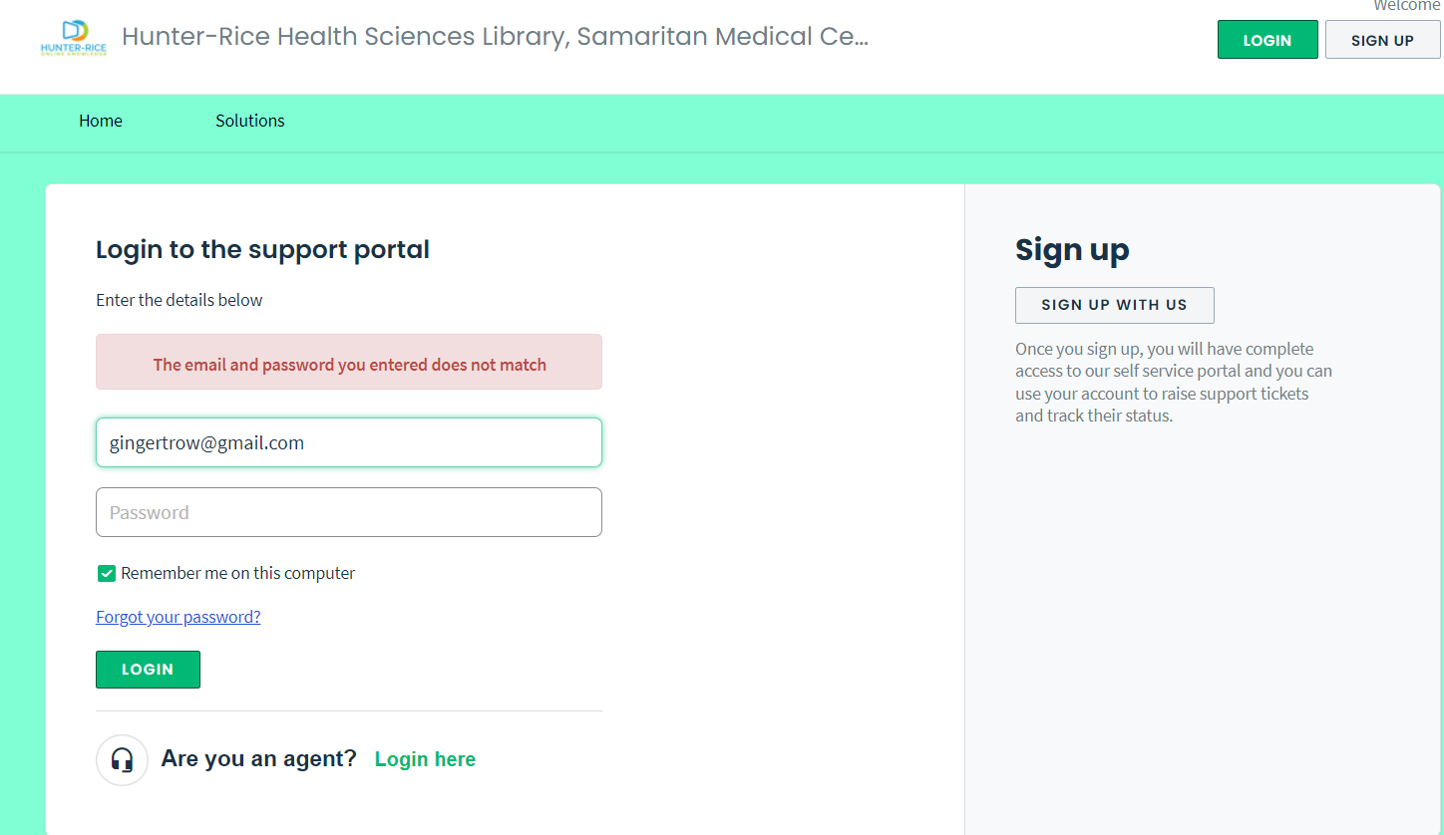
Getting Started: Sign up at our helpdesk
https://hunterricehealthscience.freshdesk.com/support/home
STEP THREE:
The activation email you receive will not contain a password. When you login the first time at the helpdesk select “Forgot your password”
Notes:
When you go back to login to the portal you’ll be asked for a password, but at this moment you do not have one. And the system does not automatically assign one. So to create on and get to your first request, you need to click on the “forgot your password” link.

Slide 7
STEP FOUR:
Type your email address and select “RESET MY PASSWORD”
Notes:
You will then arrive at this page, and type in your email and click the RESET Password button.

Slide 8
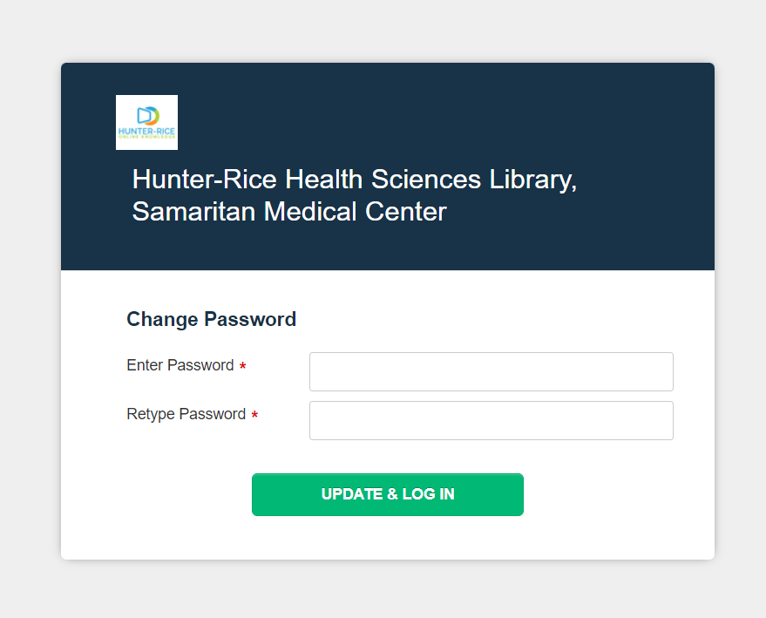
The Goofy Part –Setting up your Password
https://hunterricehealthscience.freshdesk.com/support/home
STEP FIVE:
“Change Password” is how you set up your password
Notes:
You’ll get another email directing you to this “change password” page. This is where you finally get to create a password that will then be your personal password for the site. Once you have this set, you’ll automatically be taken back to the helpdesk page and you can type in your first request.

Slide 9
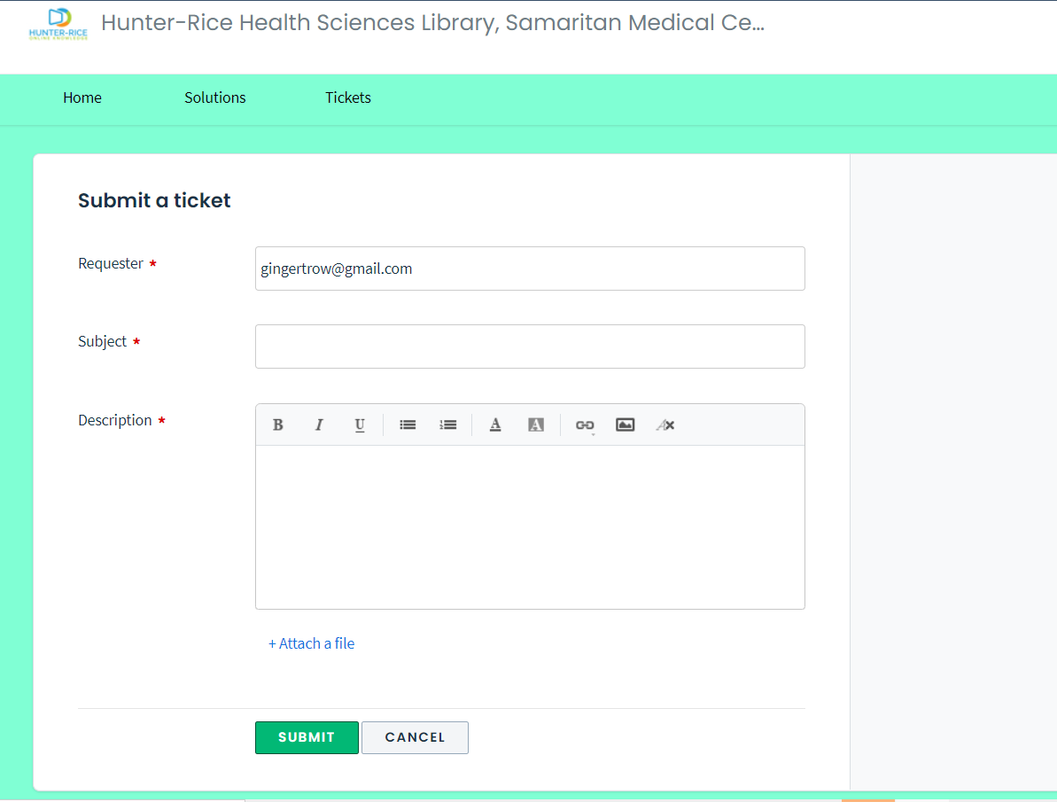
Submit Your First Request
Notes:
This is what the Request page looks like. Essentially you’ll be opening a new ticket. We ask that you submit one request at a time.
Requests that we can fill are

